Slide 1
NATIONAL UNIVERSITY OF PUBLIC SERVICE
FACULTY OF INTERNATIONAL AND EUROPEAN STUDIES
The EU Legal System and the Case Law of the Court of Justice of the EU
INITE243
Dr. Miklós Szirbik, LL.M.
24.02.2020

Slide 2
Miklós Szirbik, The EU Legal System and the Case Law of the Court of Justice of the EU
AGENDA
Introduction into legal systems of the EU
The EU Parliament
Rulings of the EU Court of Justice related to the EP

Slide 3
Miklós Szirbik, The EU Legal System and the Case Law of the Court of Justice of the EU
Introduction into legal systems of the EU
The EU has a legal system and law of its own (sui generis) - the main rules and principles are laid down in the founding Treaties. The EU can adopt legal and legislative acts, which the Member States have to respect and to apply.
Compared to that, other organizations have much less law setting capacities:
Articles 10 and 14 of the UN Charter refer to General Assembly resolutions as "recommendations„ however, they have impact on interpretation of legaly binding sources of IPL

Slide 4
Miklós Szirbik, The EU Legal System and the Case Law of the Court of Justice of the EU
Sources of EU law
The two main sources of EU law are: primary law and secondary law.
Primary law is constituted by treaties laying down the legal framework of the European Union.
Secondary law is composed of legal instruments based on these treaties, such as regulations, directives, decisions and agreements.
In addition, there are general principles of EU law, the case law developed by the European Court of Justice and international law.

Slide 5
Miklós Szirbik, The EU Legal System and the Case Law of the Court of Justice of the EU
Sources of EU law
General principles of EU law (example):
Court of Justice, Case 6/64, 15. July 1964, Costa v E.N.E.L.:
According to the precedence principle, European law is superior to the national laws of Member States. The precedence principle applies to all European acts with a binding force. Therefore, Member States may not apply a national rule which contradicts to European law.
The precedence principle guarantees the superiority of European law over national laws. It is a fundamental principle of European law. As with the direct effect principle, it is not inscribed in the Treaties, but has been enshrined by the Court of Justice of the European Union (CJEU).
Further information: https://eur-lex.europa.eu/legal-content/EN/TXT/?uri=LEGISSUM%3Al14548

Slide 6
Miklós Szirbik, The EU Legal System and the Case Law of the Court of Justice of the EU
TFEU
CHAPTER 2
LEGAL ACTS OF THE UNION, ADOPTION PROCEDURES AND OTHER PROVISIONS
SECTION 1
THE LEGAL ACTS OF THE UNION
Article 288

Slide 7
Miklós Szirbik, The EU Legal System and the Case Law of the Court of Justice of the EU
Which acts in your national law remind you on the following ones?
Art. 288 TFEU
To exercise the Union's competences, the institutions shall adopt regulations, directives, decisions, recommendations and opinions.
A regulation shall have general application. It shall be binding in its entirety and directly applicable in all Member States.
A directive shall be binding, as to the result to be achieved, upon each Member State to which it is addressed, but shall leave to the national authorities the choice of form and methods.
A decision shall be binding in its entirety. A decision which specifies those to whom it is addressed shall be binding only on them.
Recommendations and opinions shall have no binding force.

Slide 8
Miklós Szirbik, The EU Legal System and the Case Law of the Court of Justice of the EU
Examples:
Regulations - Regulation (EU) 2016/679 of the European Parliament and of the Council of 27 April 2016 on the protection of natural persons with regard to the processing of personal data and on the free movement of such data, and repealing Directive 95/46/EC (General Data Protection Regulation) (Text with EEA relevance)
https://eur-lex.europa.eu/legal-content/EN/TXT/?uri=celex%3A32016R0679

Slide 9
Miklós Szirbik, The EU Legal System and the Case Law of the Court of Justice of the EU
Examples:
Directives - Directive 2014/24/EU of the European Parliament and of the Council of 26 February 2014 on public procurement and repealing Directive 2004/18/EC Text with EEA relevance
https://eur-lex.europa.eu/legal-content/EN/TXT/?uri=celex%3A32014L0024

Slide 10
Miklós Szirbik, The EU Legal System and the Case Law of the Court of Justice of the EU
Examples:
Decisions – (1) Greece Aluminum Case, (2) Poland- Aid scheme for compensation of damage caused by the floods in Poland
http://ec.europa.eu/competition/state_aid/cases/234935/234935_1079057_10_1.pdf
http://ec.europa.eu/competition/state_aid/cases/237314/237314_1142520_25_2.pdf

Slide 11
Miklós Szirbik, The EU Legal System and the Case Law of the Court of Justice of the EU
The Procedure of law setting in the EU
Article 289 TFEU
1. The ordinary legislative procedure shall consist in the joint adoption by the European Parliament and the Council of a regulation, directive or decision on a proposal from the Commission. This procedure is defined in Article 294.
2. In the specific cases provided for by the Treaties, the adoption of a regulation, directive or decision by the European Parliament with the participation of the Council, or by the latter with the participation of the European Parliament, shall constitute a special legislative procedure.
3. Legal acts adopted by legislative procedure shall constitute legislative acts.
4. In the specific cases provided for by the Treaties, legislative acts may be adopted on the initiative of a group of Member States or of the European Parliament, on a recommendation from the European Central Bank or at the request of the Court of Justice or the European Investment Bank.

Slide 12
Miklós Szirbik, The EU Legal System and the Case Law of the Court of Justice of the EU
The Competences of the EU and the MS
CATEGORIES AND AREAS OF UNION COMPETENCE
Article 2 TFEU
1. When the Treaties confer on the Union exclusive competence in a specific area, only the Union may legislate and adopt legally binding acts, the Member States being able to do so themselves only if so empowered by the Union or for the implementation of Union acts.
2. When the Treaties confer on the Union a competence shared with the Member States in a specific area, the Union and the Member States may legislate and adopt legally binding acts in that area. The Member States shall exercise their competence to the extent that the Union has not exercised its competence. The Member States shall again exercise their competence to the extent that the Union has decided to cease exercising its competence.
3. The Member States shall coordinate their economic and employment policies within arrangements as determined by this Treaty, which the Union shall have competence to provide.
4. The Union shall have competence, in accordance with the provisions of the Treaty on European Union, to define and implement a common foreign and security policy, including the progressive framing of a common defence policy.
5. In certain areas and under the conditions laid down in the Treaties, the Union shall have competence to carry out actions to support, coordinate or supplement the actions of the Member States, without thereby superseding their competence in these areas.
Legally binding acts of the Union adopted on the basis of the provisions of the Treaties relating to these areas shall not entail harmonisation of Member States' laws or regulations.
6. The scope of and arrangements for exercising the Union's competences shall be determined by the provisions of the Treaties relating to each area.

Slide 13
Miklós Szirbik, The EU Legal System and the Case Law of the Court of Justice of the EU
The Competences of the EU and the MS
Article 3 TFEU
1. The Union shall have exclusive competence in the following areas:
(a) customs union;
(b) the establishing of the competition rules necessary for the functioning of the internal market;
(c) monetary policy for the Member States whose currency is the euro;
(d) the conservation of marine biological resources under the common fisheries policy;
(e) common commercial policy.
2. The Union shall also have exclusive competence for the conclusion of an international agreement when its conclusion is provided for in a legislative act of the Union or is necessary to enable the Union to exercise its internal competence, or in so far as its conclusion may affect common rules or alter their scope.

Slide 14
Miklós Szirbik, The EU Legal System and the Case Law of the Court of Justice of the EU
Article 4 TFEU
1. The Union shall share competence with the Member States where the Treaties confer on it a competence which does not relate to the areas referred to in Articles 3 and 6.
2. Shared competence between the Union and the Member States applies in the following principal areas:
(a) internal market;
(b) social policy, for the aspects defined in this Treaty;
(c) economic, social and territorial cohesion;
(d) agriculture and fisheries, excluding the conservation of marine biological resources;
(e) environment;
(f) consumer protection;
(g) transport;
(h) trans-European networks;
(i) energy;
(j) area of freedom, security and justice;
(k) common safety concerns in public health matters, for the aspects defined in this Treaty.
3. In the areas of research, technological development and space, the Union shall have competence to carry out activities, in particular to define and implement programmes; however, the exercise of that competence shall not result in Member States being prevented from exercising theirs.
4. In the areas of development cooperation and humanitarian aid, the Union shall have competence to carry out activities and conduct a common policy; however, the exercise of that competence shall not result in Member States being prevented from exercising theirs.

Slide 15
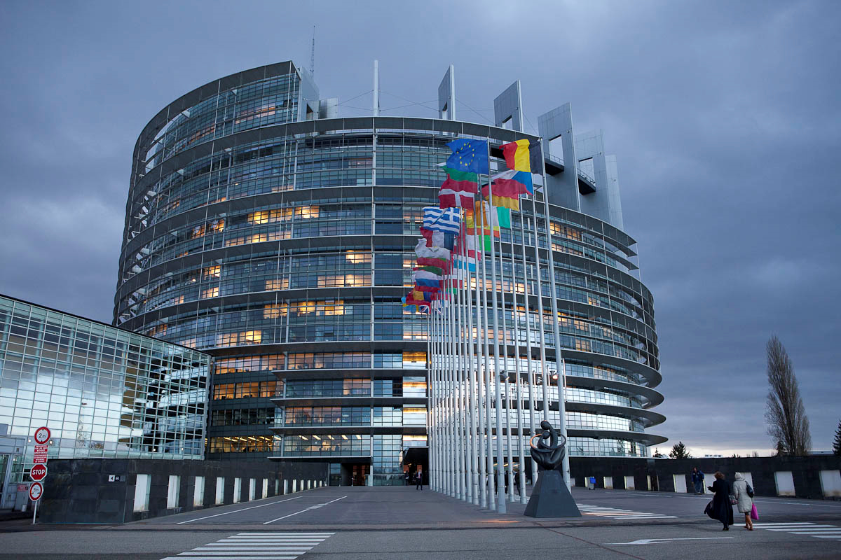
Miklós Szirbik, Public Law of the European Union
The European Parliament

Slide 16
Miklós Szirbik, The EU Legal System and the Case Law of the Court of Justice of the EU
History of EP
1952-1957: Consultative Assembly
Its members were elected by the national parliaments of the MS. As indicated in the name, it had to be heard by the Council while lawsetting but it did not create the itself the European legal sources.
In 1979 shortly after the 1957 Treaties the EP was elected directly for the first time and it broadened its importance continuously. Today it is a co-legislative organ.

Slide 17
Miklós Szirbik, The EU Legal System and the Case Law of the Court of Justice of the EU
EPP since July 2019: David-Maria Sassoli

Slide 18
Miklós Szirbik, Miklós Szirbik, Legal System of the EU
Legislation in the EU
RELEVANCE of EU law-setting
The largest Economy in the world, close to 500 Mio citizens:
During the 7th legislature (2009-2014) the Commission presented 584 proposals falling under the co-decision/legislative ordinary procedure, up from 508 during the 6th legislature (2004-2009) and 432 during the 5th legislature (1999-2004).
During the 7th legislature, proposals for the co-decision/ordinary legislative procedure amounted to 89% of all 658 legislative proposals from the Commission, compared to 49% during the 6th legislation (out of 1041 proposals), 42% during the 5th legislation (out of 1028 proposals) and 21% during the 4th legislation (1994-1999).

Slide 19
Miklós Szirbik, Miklós Szirbik, Legal System of the EU
Legislation in the EU
Forms of EU law-setting
In the adoption of legislative acts, a distinction is made between the ordinary legislative procedure (codecision), which puts Parliament on an equal footing with the Council, and the special legislative procedures, which apply only in specific cases where Parliament has only a consultative role.
On certain questions (e.g. taxation) the European Parliament gives only an advisory opinion (the ‘consultation procedure’). In some cases the Treaty provides that consultation is obligatory, being required by the legal base, and the proposal cannot acquire the force of law unless Parliament has delivered an opinion. In this case the Council is not empowered to take a decision alone.

Slide 20
Miklós Szirbik, Miklós Szirbik, Legal System of the EU
Legislation in the EU
Consultation
The European Parliament may approve or reject a legislative proposal, or propose amendments to it. The Council is not legally obliged to take account of Parliament’s opinion but in line with the case-law of the Court of Justice, it must not take a decision without having received it.
In the beginning, the 1957 Treaty of Rome gave Parliament an advisory role in the legislative process; the Commission proposed and the Council adopted legislation.
The Single European Act (1986) and the Maastricht, Amsterdam, Nice and Lisbon Treaties successively extended Parliament’s prerogatives. It can now co-legislate on equal footing with the Council in a vast majority of areas (see Ordinary legislative procedure) and consultation became a special legislative procedure (or even a non-legislative procedure) used in a limited number of cases.
This procedure is now applicable in a limited number of legislative areas, such as internal market exemptions and competition law. Parliament´s consultation is also required, as a non-legislative procedure, where international agreements are being adopted under the Common Foreign and Security Policy (CFSP).

Slide 21
Miklós Szirbik, Miklós Szirbik, Legal System of the EU
Legislation in the EU
Ordinary legislative procedure
Art. 294 TFEU
1. Where reference is made in the Treaties to the ordinary legislative procedure for the adoption of an act, the following procedure shall apply.
2. The Commission shall submit a proposal to the European Parliament and the Council.
Question: what does the term “act” cover in Art. 294 paragraph 1? Support your answer with a relevant Article of the TFEU discussed in earlier classes!

Slide 22
Miklós Szirbik, Miklós Szirbik, Legal System of the EU
Legislation in the EU
Ordinary legislative procedure
Art. 294 TFEU
“First reading” according to paragraphs 3-6 of Art. 294 TFEU
3. The European Parliament shall adopt its position at first reading and communicate it to the Council.
4. If the Council approves the European Parliament's position, the act concerned shall be adopted in the wording which corresponds to the position of the European Parliament.
5. If the Council does not approve the European Parliament's position, it shall adopt its position at first reading and communicate it to the European Parliament.
6. The Council shall inform the European Parliament fully of the reasons which led it to adopt its position at first reading. The Commission shall inform the European Parliament fully of its position.

Slide 23
Miklós Szirbik, Miklós Szirbik, Legal System of the EU
Legislation in the EU
Ordinary legislative procedure
Art. 294 TFEU
“Second reading” according to paragraphs 7-9 of Art. 294 TFEU
7. If, within three months of such communication, the European Parliament:
(a) approves the Council's position at first reading or has not taken a decision, the act concerned shall be deemed to have been adopted in the wording which corresponds to the position of the Council;
(b) rejects, by a majority of its component members, the Council's position at first reading, the proposed act shall be deemed not to have been adopted;
(c) proposes, by a majority of its component members, amendments to the Council's position at first reading, the text thus amended shall be forwarded to the Council and to the Commission, which shall deliver an opinion on those amendments.
8. If, within three months of receiving the European Parliament's amendments, the Council, acting by a qualified majority:
(a) approves all those amendments, the act in question shall be deemed to have been adopted;
(b) does not approve all the amendments, the President of the Council, in agreement with the President of the European Parliament, shall within six weeks convene a meeting of the Conciliation Committee.
9. The Council shall act unanimously on the amendments on which the Commission has delivered a negative opinion.

Slide 24
Miklós Szirbik, Miklós Szirbik, Legal System of the EU
Legislation in the EU
Ordinary legislative procedure
Art. 294 TFEU
“Conciliation” according to paragraphs 10-12 of Art. 294 TFEU
10. The Conciliation Committee, which shall be composed of the members of the Council or their representatives and an equal number of members representing the European Parliament, shall have the task of reaching agreement on a joint text, by a qualified majority of the members of the Council or their representatives and by a majority of the members representing the European Parliament within six weeks of its being convened, on the basis of the positions of the European Parliament and the Council at second reading.
11. The Commission shall take part in the Conciliation Committee's proceedings and shall take all necessary initiatives with a view to reconciling the positions of the European Parliament and the Council.
12. If, within six weeks of its being convened, the Conciliation Committee does not approve the joint text, the proposed act shall be deemed not to have been adopted.

Slide 25
Miklós Szirbik, Miklós Szirbik, Legal System of the EU
Legislation in the EU
Ordinary legislative procedure
Art. 294 TFEU
“Third reading” according to paragraphs 13-15 of Art. 294 TFEU
13. If, within that period, the Conciliation Committee approves a joint text, the European Parliament, acting by a majority of the votes cast, and the Council, acting by a qualified majority, shall each have a period of six weeks from that approval in which to adopt the act in question in accordance with the joint text. If they fail to do so, the proposed act shall be deemed not to have been adopted.
14. The periods of three months and six weeks referred to in this Article shall be extended by a maximum of one month and two weeks respectively at the initiative of the European Parliament or the Council.
Special provisions
15. Where, in the cases provided for in the Treaties, a legislative act is submitted to the ordinary legislative procedure on the initiative of a group of Member States, on a recommendation by the European Central Bank, or at the request of the Court of Justice, paragraph 2, the second sentence of paragraph 6, and paragraph 9 shall not apply.
In such cases, the European Parliament and the Council shall communicate the proposed act to the Commission with their positions at first and second readings. The European Parliament or the Council may request the opinion of the Commission throughout the procedure, which the Commission may also deliver on its own initiative. It may also, if it deems it necessary, take part in the Conciliation Committee in accordance with paragraph 11.

Slide 26
Miklós Szirbik, Miklós Szirbik, Legal System of the EU
Legislation in the EU
Other legislative procedures
Opinion under Article 140 Treaty on the Functioning of the European Union (monetary union)
The Commission and the European Central Bank draw up reports for the Council on the progress in fulfilling their obligations as regards economic and monetary union of Member States with a derogation.After Parliament has delivered its opinion, the Council on the Commission’s proposal, decides which Member States with a derogation fulfil the conditions for adoption of the single currency on the basis of the criteria laid down in Article 140(1) TFEU and ends these Member States’ derogations. In this procedure, Parliament votes for the amendments en bloc and cannot table amendments.

Slide 27
Miklós Szirbik, Miklós Szirbik, Legal System of the EU
Legislation in the EU
Summary material of EP related to legislation with additional information:
https://www.europarl.europa.eu/about-parliament/hu/powers-and-procedures/legislative-powers

Slide 28
Miklós Szirbik, The EU Legal System and the Case Law of the Court of Justice of the EU
European Court of Justice decides in favor of European Parliament in cod case - Case C-124/13
https://eur-lex.europa.eu/legal-content/EN/TXT/?uri=uriserv:OJ.C_.2013.156.01.0021.01.ENG
http://ebcd.org/european-court-of-justice-decides-in-favor-of-european-parliament-in-cod-case/

Slide 29
Miklós Szirbik, The EU Legal System and the Case Law of the Court of Justice of the EU
European Court of Justice decides in favor of European Parliament in - Case C‑73/17 (France v. EP)

Slide 30
Thank you for your attention!

